Slide 1


SURYA GROUP OF INSTITUTIONS
ANBU A
422221104006
eBPL-Artificial Intelligence
TEAM-01

Slide 2

Building a Smarter AI-Powered Spam Classifier
In today's digital age, spam emails are an undeniable nuisance. Our cutting-edge AI technology enables us to distinguish between spam and legitimate emails with unprecedented accuracy. With our spam classifier, you can rest assured that your inbox remains free from unwanted emails.

Slide 3
Why Traditional Filters Fall Short
Basic Filters
Bayesian Filters
Content Filters
Basic filters work by blocking all emails from a particular sender or containing certain keywords. But these filters are not effective as spammers can easily bypass them by using different email addresses and creating new keywords.
Bayesian filters are widely used and calculate a probability based on words and phrases contained in an email that is either spam or not. However, these filters can be easily fooled by simple tactics like misspelled words or random characters.
Content-based filters analyze the actual content of the email to check for spam-like qualities, including using large font size, excessive capitalization, and more, but they also lack the accuracy of our smart AI-powered solution.

Slide 4
How Our Spam Classifier Works
1
Step 1: Text Analysis
Our advanced algorithm analyzes the text of the email to detect specific patterns and keywords that are commonly associated with spam emails.
2
Step 2: Image Analysis
In addition to text analysis, our spam classifier also looks at any embedded images in emails to detect patterns commonly associated with spammy messages.
3
Step 3: Sender Analysis
Our AI-powered solution checks the domain name of the sender to detect whether it is a legitimate sender or not, helping to further refine the accuracy of our spam classifier.

Slide 5

Increased Productivity and Peace of Mind
Reduce Stress
By filtering out all unwanted emails, our spam classifier ensures that your inbox contains only the important, work-related messages, helping you stay focused and productive.
Save Time
Manually filtering out spam emails is time-consuming and frustrating. Our advanced system instantly deletes unwanted emails before they even hit your inbox, saving you precious time.

Slide 6

Customizable Solutions for Your Business Needs
Flexible Plans
Our spam classifier offers customizable plans to fit the size of your business and specific needs.
24/7 Support
Our team is dedicated to providing you with round-the-clock support and maintenance to ensure that our spam classifier always works flawlessly.
No More False Positives
Our smart AI-powered system is designed to significantly reduce the number of false positives, ensuring that legitimate mails are not automatically filtered out as spam.

Slide 7
Expertise You Can Trust
Our spam classifier has been designed and perfected by a team of experienced professionals that continuously work to improve to ensure that your emails are always safe and secure.

Slide 8
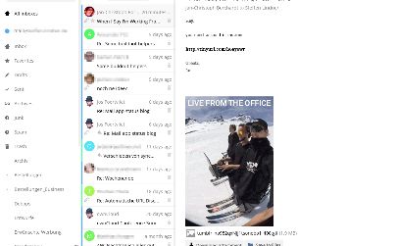
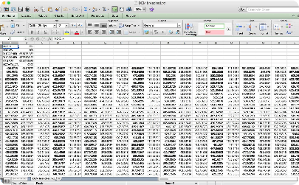

Seamless Integration
Mail Integrations
Reporting
Collaborative Filtering
Our system seamlessly integrates with your favorite mail service providers for a hassle-free experience.
Our comprehensive spam reports allow you to monitor the effectiveness of our system to ensure that you stay on top of all your emails.
Our collaborative filtering solution allows you to train the algorithm with your own data to ensure maximum accuracy and relevance for your business.

Slide 9
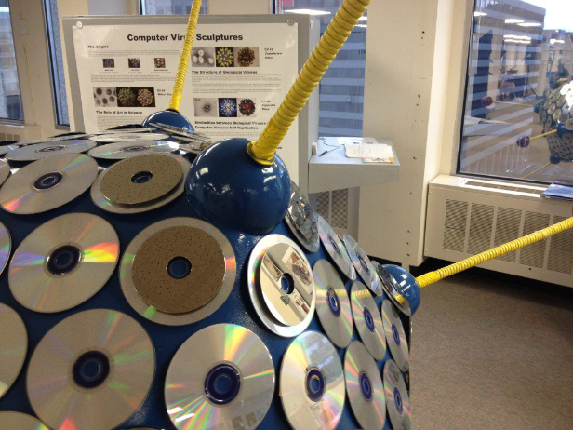
Stay Protected Against the Latest Threats
Our AI-powered system is constantly updated to ensure that it stays ahead of the latest threats and trends in the world of spam emails, ensuring that you are always protected against even the newest and most dangerous threats.

Slide 10

The Benefits of Using Our Spam Classifier
1
Intelligence
2
Convenience
3
Customization
Our advanced system uses machine learning algorithms to analyze and classify spam emails intelligently, ensuring that you never receive unwanted emails.
Our spam classifier integrates flawlessly with your existing email service provider and requires no additional setup on your part, making it incredibly fast and convenient to use.
With our customizable plans, you are sure to find a solution that works for your specific needs and requirements, no matter how complex they may be.

Slide 11
Affordable Pricing
Plan
Monthly Cost
Features
Basic Plan
$25/mo
1000 emails/day Unlimited support
Standard Plan
$50/mo
5000 emails/day Collaborative filtering
Premium Plan
$99/mo
10000 emails/day Customizability

Slide 12

Enhanced Security Measures
We understand the importance of keeping your sensitive information secure, which is why our spam classifier always adheres to the highest security standards and offers advanced data encryption and protection.

